Slide 1
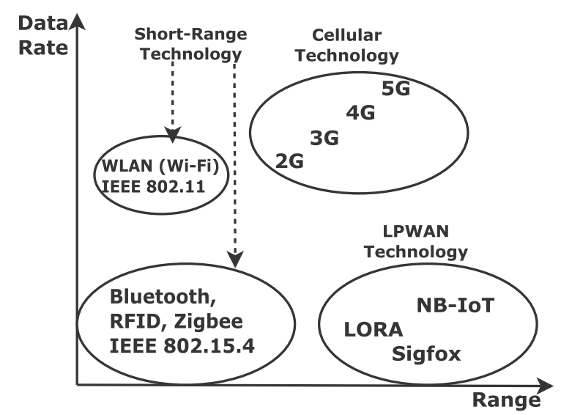
Feature | IEEE 802.11 (Wi-Fi) | IEEE 802.15.4 (WPAN, Bluetooth,Zigbee)
Definition | Higher power, high data rate (up to several Gbps), short -moderate range (up to 100 meters). | Low power, low data rate (up to 250 kbps), short range (10-30 meters).
Modulation Techniques | DSSS, BPSK, ASK, OFDM, FHSS, QAM | DSSS, BPSK, ASK, O-QPSK, CSS
Physical Layer (PHY) | Multiple sublayers: PLCP and PMD | Single PHY layer
Channel Access Method | CSMA/CA with optional RTS/CTS | CSMA/CA
Security | WPA, WPA2, WPA3 | AES-128 encryption
Network Topologies | Ad Hoc, Mesh | Star, Peer-to-Peer, Mesh

Slide 2
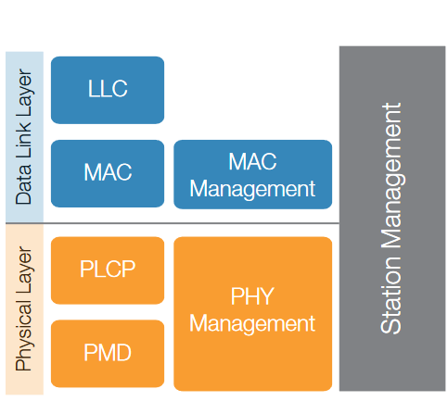
WiFi IEEE 802.11 Protocol Layers
1. Data Link Layer
Logical Link Control (LLC): frame synchronization, flow control, and error checking.
MAC (Media Access Control): handles tasks like frame addressing (MAC addresses), and ensuring that data frames are transmitted and received without collisions using techniques like CSMA/CA (Carrier Sense Multiple Access with Collision Avoidance).
MAC Management: This block manages the MAC layer's operations, such as coordinating communication with other stations.
2. Physical Layer
PLCP (Physical Layer Convergence Procedure): responsible for converting the data received from the MAC layer into a frame for transmission over the physical medium.
PMD (Physical Medium Dependent): concerned with the actual transmission and reception of data over the physical medium. It specifies the modulation and coding techniques used to transmit the data bits.
PHY Management: oversees the operations of the physical layer. It manages functions like scanning for available channels, selecting the best frequency.
3. Station Management: interfaces with both the MAC and PHY layers to manage the overall operation of the station (device). It handles tasks such as managing connections to the network, coordinating the different power-saving modes.

Slide 3
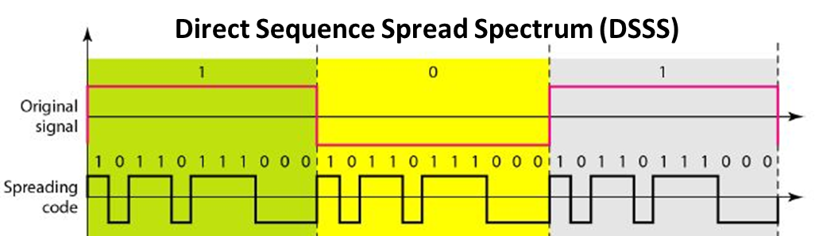
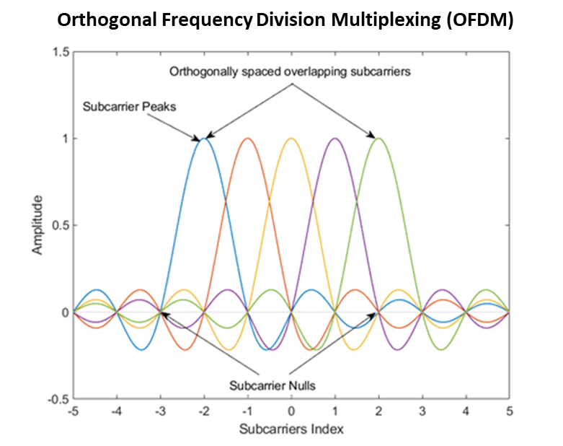
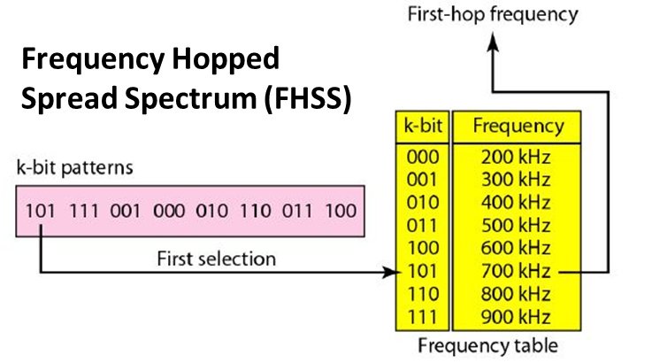
Modulation Schemes for IEEE 802.11 Standard (WiFi)
1. Direct Sequence Spread Spectrum (DSSS)
Spreads data across a wide frequency band to reduce interference.
Low data rates.
Resistant to multipath fading.
2. Orthogonal Frequency Division Multiplexing (OFDM)
Divides the frequency band into multiple subcarriers, each carrying part of the data.
High spectral efficiency
high data rates.
Robust against multipath fading and interference.
3. Frequency Hopped Spread Spectrum (FHSS)
Rapidly changes the carrier frequency over a wide band in a pseudo-random sequence.
Offers good interference resistance and security.
Supports lower data rates
Less spectrum-efficient

Slide 4
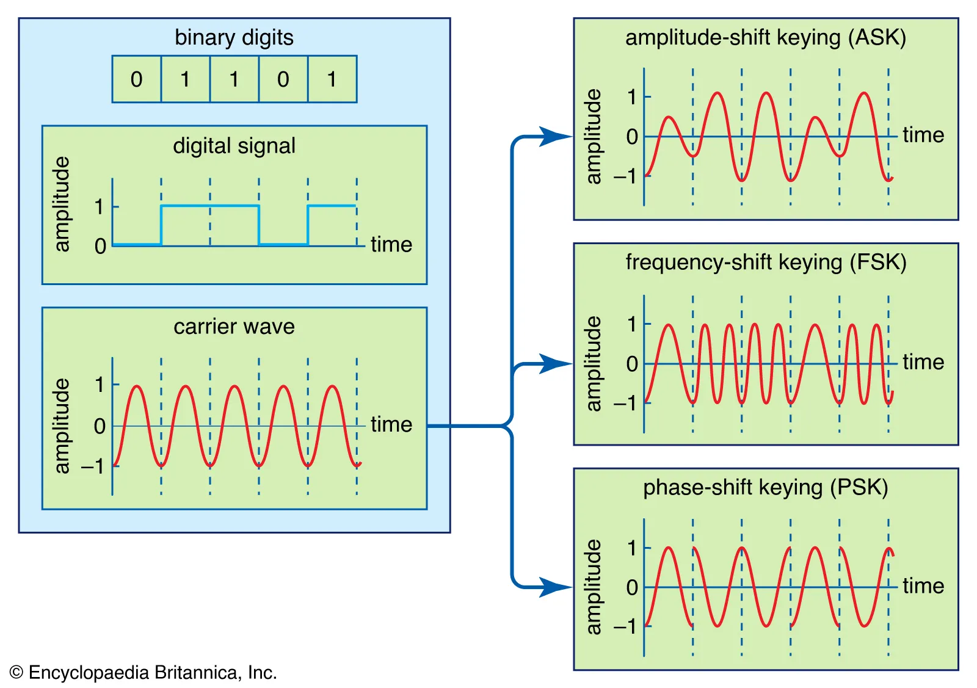
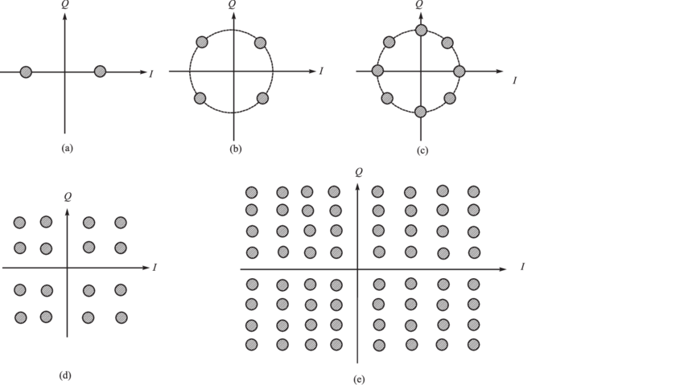
4. Binary Phase Shift Keying (BPSK)
Simple phase modulation with two states (binary 0 and 1).
Highly robust against noise and interference.
Lower data rates.
ASK, FSK, PSK (refer to diagram)
6. Amplitude Modulation (QAM)
It combines phase modulation and amplitude modulation.
It can achieve a higher rate than common amplitude modulation and phase modulation, which support only two types of symbols to distinguish 0 and 1.
QAM can modulate more symbols, and each symbol has its own phase and amplitude.
Constellation diagram of (a) BPSK, (b) QPSK, (c) 8PSK, (d) 16QAM and (e) 64QAM

Slide 5
IEEE 802.15.4 Protocol
IEEE 802.15.4 protocol has a low data rate, low complexity, long battery life, and short-range communication.
This is meant for Wireless Personal Area Network (WPAN) which uses wearable devices.
Modulation Schemes for IEEE 802.15.4 Standard (Bluetooth,Zigbee)
Binary Phase Shift Keying (BPSK), Direct Sequence Spread Spectrum (DSSS), Amplitude Shift Keying (ASK)
Offset Quadrature Phase Shift Keying (O-QPSK)
In O-QPSK, the in-phase (I) and quadrature (Q) components are offset by half a symbol period, which reduces the peak-to-average power ratio (PAPR) and improves efficiency in power-constrained devices.
Provides a good balance between data rate and power efficiency.
Less susceptible to errors caused by sudden phase shifts.
Chirp Spread Spectrum (CSS)
CSS modulates the signal by sweeping (chirping) the carrier frequency over a wide band.
Excellent resistance to interference and multipath effects.
Suitable for long-range communication with low power.
Typically results in lower data rates due to the spreading.

Slide 6
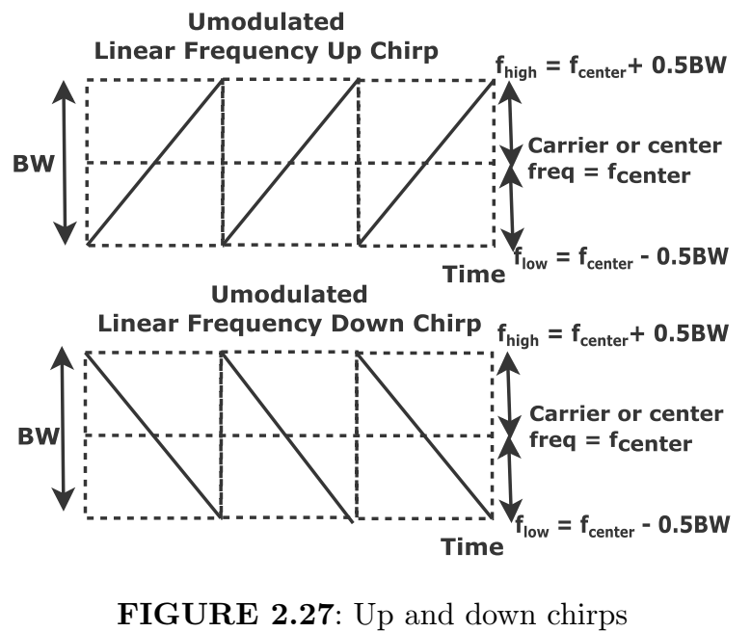
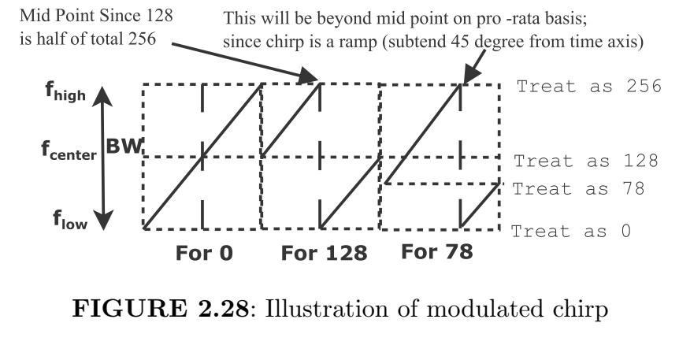
Modulation- Chirp Spread Spectrum
In chirp spread spectrum, the information is encoded by a wideband linear frequency chirp which acts as a carrier signal. The frequency increases and decreases linearly with time in up chirp and down chirp.
For decimal zero, the up chirp goes from flow to fhigh.
For decimal 128, the chirp starts from the center frequency goes until fhigh. Again it resumes from 0 at the midpoint of the time interval and goes until center frequency.
Note that the chirp starts from the midpoint of frequency and resumes from the midpoint of the time interval because 128 is half of the allowed decimal 256.
Also, all segments of the chirp subtend an angle of 45 degrees from the time axis.
On similar lines, we can draw the modulated chirp for decimal 78.

Slide 7
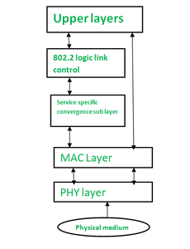
IEEE 802.15.4 Protocol
Physical layer (PHY): responsible for transmitting and receiving data bits over the physical medium, such as radio waves. The PHY layer also defines the modulation and coding schemes used for data transmission.
MAC layer: responsible for coordinating access to the shared wireless medium. It uses a carrier sense multiple access (CSMA) protocol with collision avoidance to prevent multiple devices from transmitting at the same time. The MAC layer also handles frame synchronization, error detection and correction, and security.
Service specific convergence sublayer: provides a bridge between the MAC layer and the upper layers. It can be used to support different types of services, such as data, voice, and video.
Logic link control: This layer is responsible for managing the logical link between two devices. It handles flow control, error recovery, and sequencing of data packets.
Upper layers: These layers are not defined by the IEEE 802.15.4 standard and can vary depending on the specific application. They may include layers such as the network layer, transport layer, and application layer.

Slide 8
Topology
Zigbee or PAN Coordinator is the head coordinator who initiates, maintains, and controls the network. This acts as a gateway for connecting to other networks and is main powered.
Zigbee Router or Full Function Device (FFD) acts as a router or at times PAN coordinator by relaying packets for extending the range. This is below the PAN coordinator in the hierarchy and allows communication with any device of the network.
Zigbee Device or Reduced Function Device (RFD) is a very simple device that collects the data from things. This is the leaf node and battery-powered. RFD is below the FFD in the hierarchy.

Slide 9
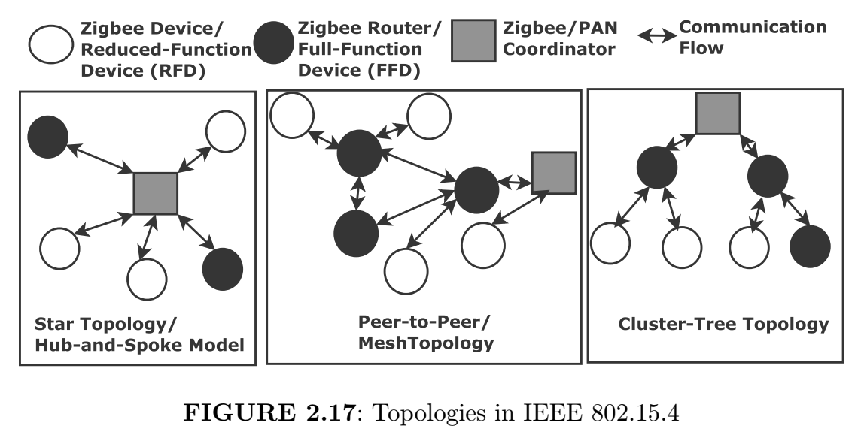
Star Topology:
Both FFDs and RFDs are only connected to the
PAN coordinator.
There is a single PAN coordinator and no router.
Mesh Topology:
The topology has one PAN coordinator and several FFDs and RFDs.
Any device can be connected to any other device if they are in their coverage area.
However, two RFDs cannot be connected.
Cluster-Tree Topology:
There is a parent (PAN coordinator/FFD) and children (FFD/RFD) paradigm in this topology.
A cluster head is chosen and this broadcasts beacon frames to neighbors.
The neighboring device requests the cluster head acting as a parent to join the network.
Subsequently, this is added as a child node. Here, a large coverage area is achievable, however, it has high latency because of chained clusters.

Slide 10
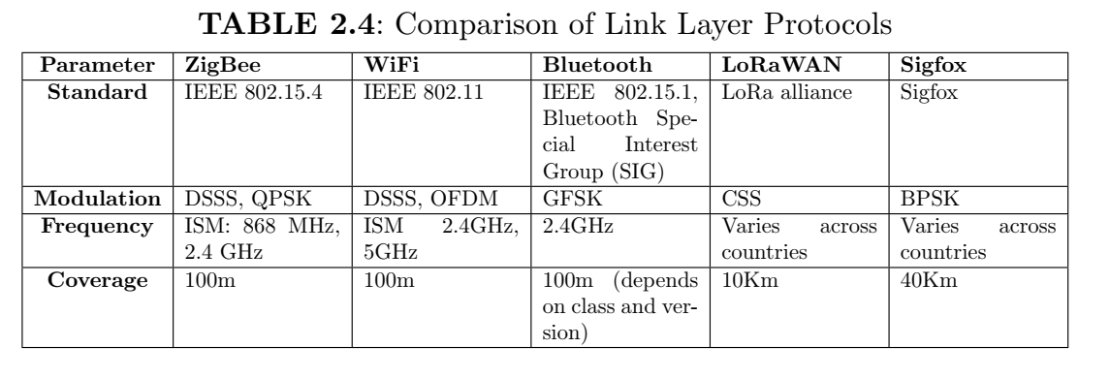

Slide 11
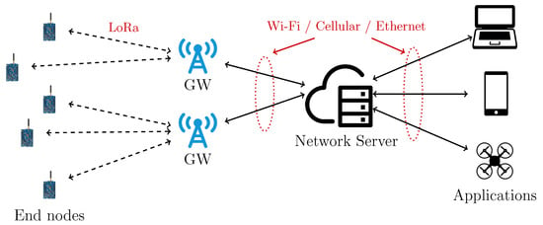
LoRaWAN Protocol
End Node: Battery-powered device with sensor, wireless transceiver, microcontroller, and antenna.
Gateway: Collects data from multiple end nodes and sends it to the network server via networks (cellular, Ethernet, Wi-Fi).
Adaptive Data Rates: High-capacity gateways use adaptive data rates and multichannel multi-modem transceivers to handle different frequencies and spreading factors simultaneously.
Spreading Factor: Controls data transmission speed, chirp rate, range, congestion, time-on-air, battery life, and receiver sensitivity.
Chirp Modulation: Uses sinusoidal waveforms with linearly increasing or decreasing frequency over time, known as chirps.
Network Server: manages the gateway, filtering of redundant data, performs security verification, scheduling of ACK through the optimal gateway, performs adaptive data rate control amongst others.
Long Range Wide Area Networks (LoRaWAN) protocol
uses an unlicensed ISM radio band - the data rate is low and interferences exist as anyone can use these frequencies.
The applications are microwaves, ovens, and medical equipment (temperature, the humidity not for audio or video message)
LoRaWAN is used for low power, low data rate, and long-range communication.

Slide 12
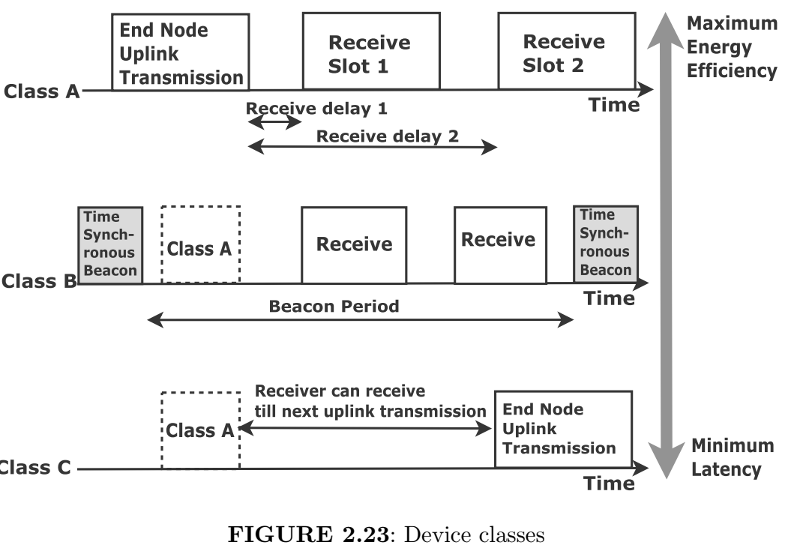
Device Class

Slide 13
Device Class
There are three classes of LoRaWAN devices. All device classes B and C can act like a class A(ll).
The device does bidirectional communication. It is battery-powered and the most energy efficient. The communication model used is uplink transmission by end node, then two receive windows open up after some delay for downlink communication.
In class B(eacon), the features are bidirectional communication, having scheduled receive slots, and a battery-powered actuator. The end node receives a time-synchronized beacon for timing reference from the gateway so that the server or gateway knows when the end nodes listen on those extra receive slots or ping slots used to initiate a downlink communication.
In class C(ontinuous), the features are bidirectional communication, main powered actuator, least energy-efficient, and least latency. It is the same as class A but these devices listen continuously.

Slide 14
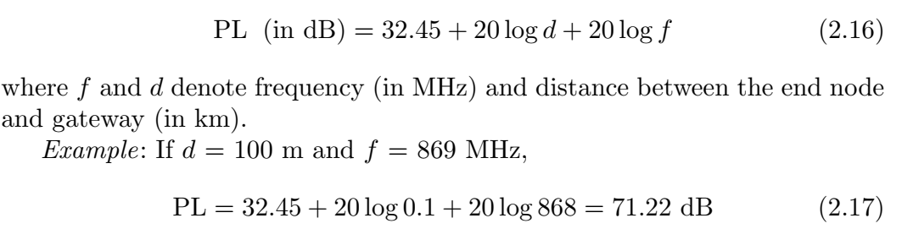
Radio Propagation
PL=power loss

Slide 15
Link Budget
Received Signal Strength Indicator (RSSI) is the sum of transmitted power, all gains, and losses.
Receiver sensitivity is the minimum received power that a receiver can detect or demodulate.
RSSI must be greater than receiver sensitivity for correct reception.
For example, receiver sensitivity = -95 dBm.
Receiver sensitivity should be as low as possible.
Link margin is the difference between RSSI and receiver sensitivity.
For example, if RSSI = -70 dBm, then the link margin = -70 - (-95) = 25 dBm = 316 mW. LoRa protocol has a sensitivity of -148 dBm due to chirp spread spectrum modulation.
SNR, the difference of RSSI and noise power in dB scale, varies between -20 dBm to +10 dBm.
The maximum link budget is the difference between transmitted power and receiver sensitivity. For example, the maximum link budget is equal to 30 - (-148) = 178 dBm, if transmitted power is 30 dBm and receiver sensitivity, is -148 dBm.

Slide 16
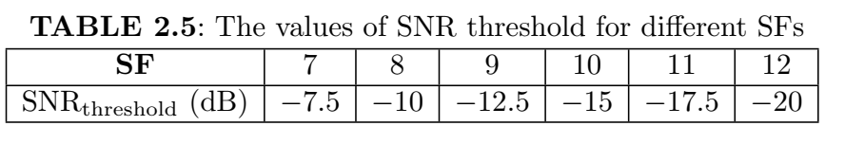
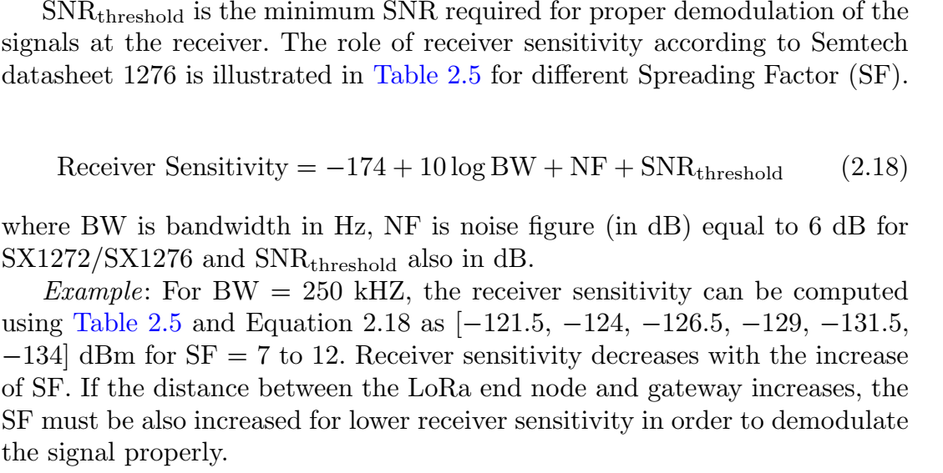
Link Budget

Slide 17
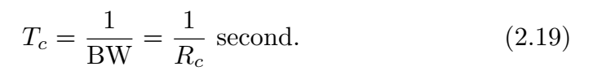
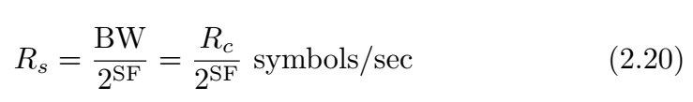
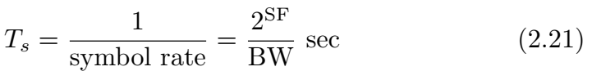
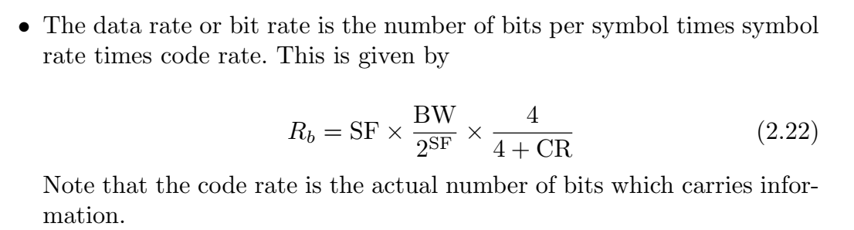
Rate Definitions
The terminologies for LoRaWAN rate are listed below:
Bandwidth (BW) is the number of cycler per second or Hertz. The bandwidth is equal to chip rate, Rc chips/sec.
Chip duration is given by
Spreading factor is the number of raw bits that are used for encoding a symbol. It varies from 7 to 12.
Symbol represents one or more bits of data. It has 2^{SF} values.
The symbol rate is given by
The symbol duration is expresses as

Slide 18
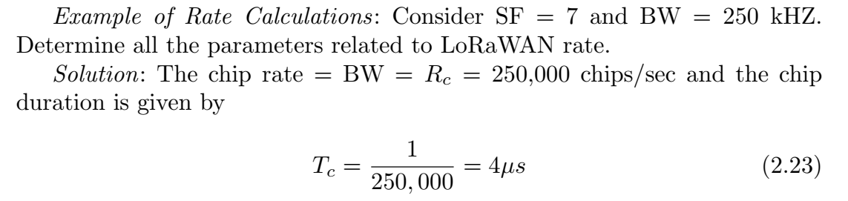
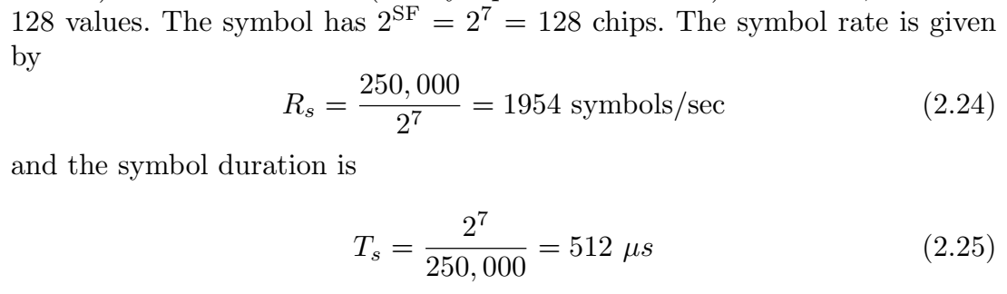
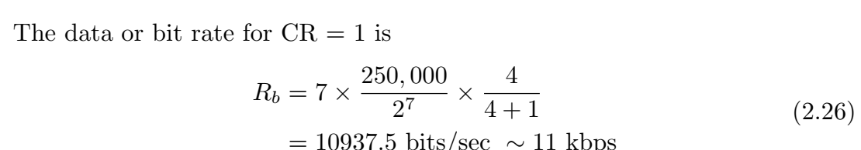

Slide 19
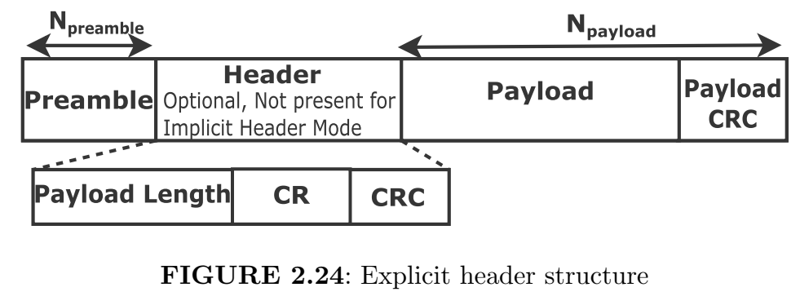
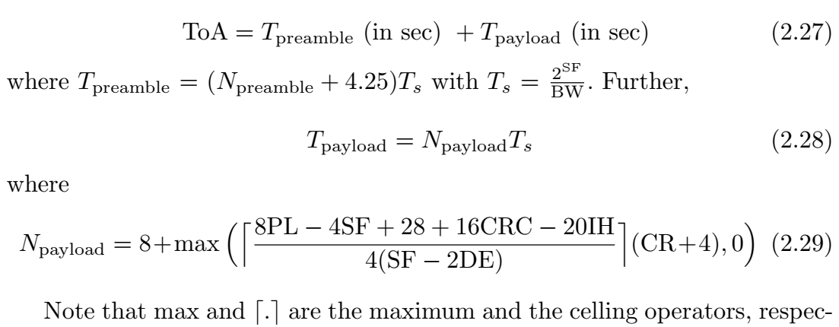
Time of Air
The explicit header structure is shown in Figure 2.24. This consists of preamble, payload, and header (optional). Time of Air (ToA) is the packet transmission time. This is the amount of time needed for a data packet to travel from a transmitter to a receiver. The distance between the transmitter and the receiver is proportional to ToA. ToA is given by

Slide 20
Npreamble is 8 symbols for EU868.
PL is Packet Length in the number of bytes.
IH is an Implicit Header. This is 0 for header enabled for LoRaWAN. and 1 otherwise.
CRC is Cyclic Redundancy Check. This is 1 for an enabled case which is by default in LoRaWAN and 0 for a disabled case.
CR is coding rate equal to f1; 2; 3; 4g. This is by default 1 for LoRaWAN.
DE is data rate optimization and DE is 1 for low data rate for BW 125 kHz and SF ≥ 11.

Slide 21
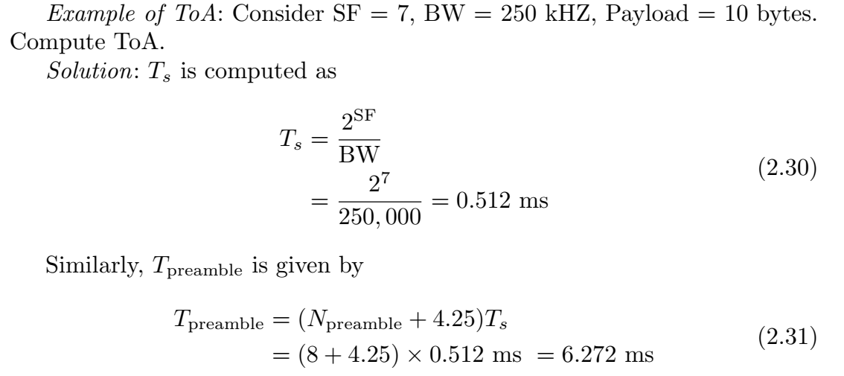
Example:

Slide 22
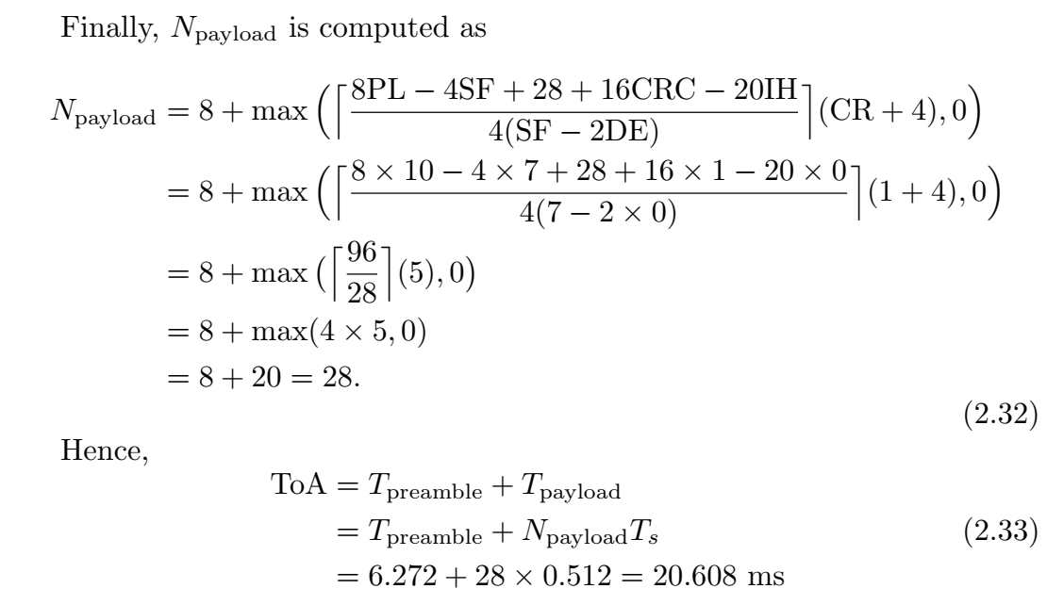

Slide 23
Pure ALOHA vs Slotted ALOHA
Pure ALOHA:
Transmission: A node sends data frames whenever it has data to send, without considering when other nodes might be transmitting.
Collision Detection: After sending a frame, the node waits for an acknowledgment (ACK) within a specified time period. If no ACK is received, the node assumes a collision occurred and the frame was lost.
Retransmission: The node waits for a random time interval before attempting to retransmit the frame. The waiting time is random to reduce the chance of repeated collisions with other nodes retransmitting at the same time.
Slotted ALOHA:
Time Slot Synchronization: The network is divided into discrete time slots, and nodes are synchronized to these slots.
Transmission: Nodes can only start transmission at the beginning of a time slot. The node waits until the start of the next time slot to send a frame.
Collision Detection: After transmitting at the start of a time slot, the node waits for an acknowledgment within a specific time frame. If no ACK is received, it assumes a collision occurred.
Retransmission: The node waits for a random number of time slots before attempting to retransmit the frame to minimize the chance of collisions.

Slide 24
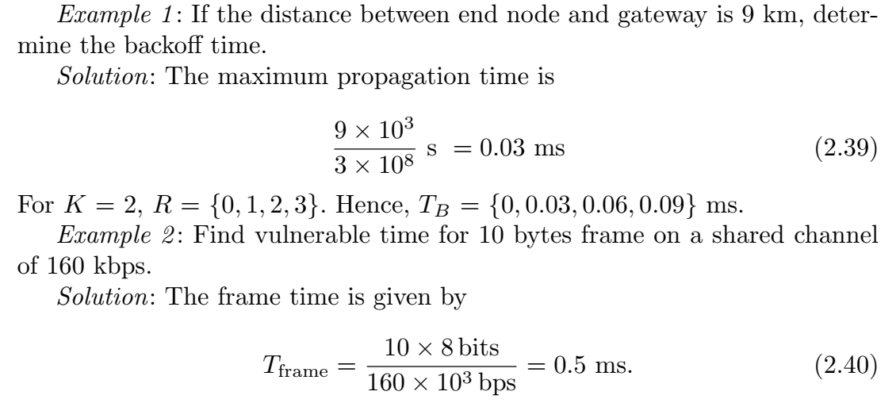
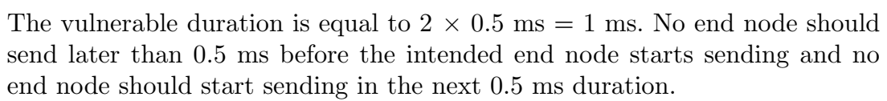

Slide 25
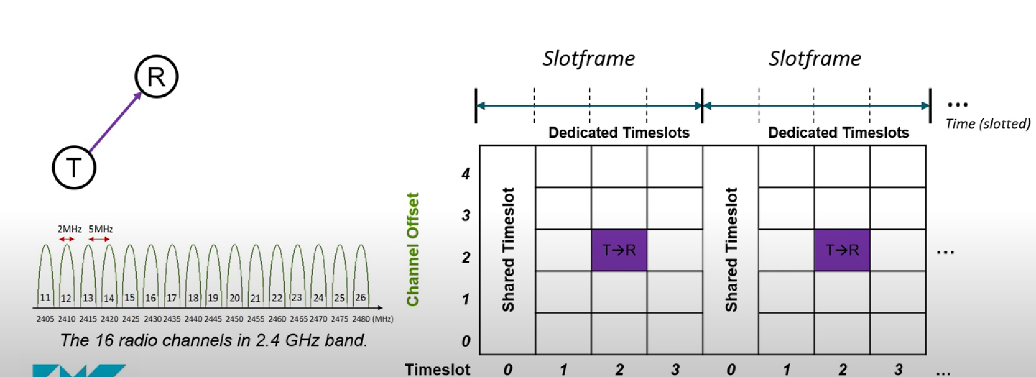
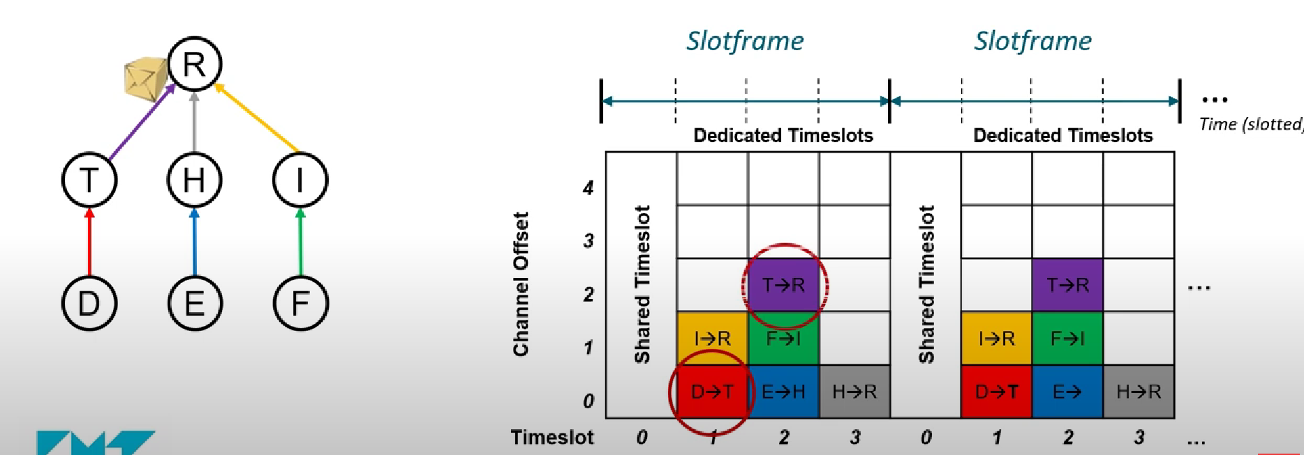
Time Slotted Channel Hopping (TSCH)

Slide 26
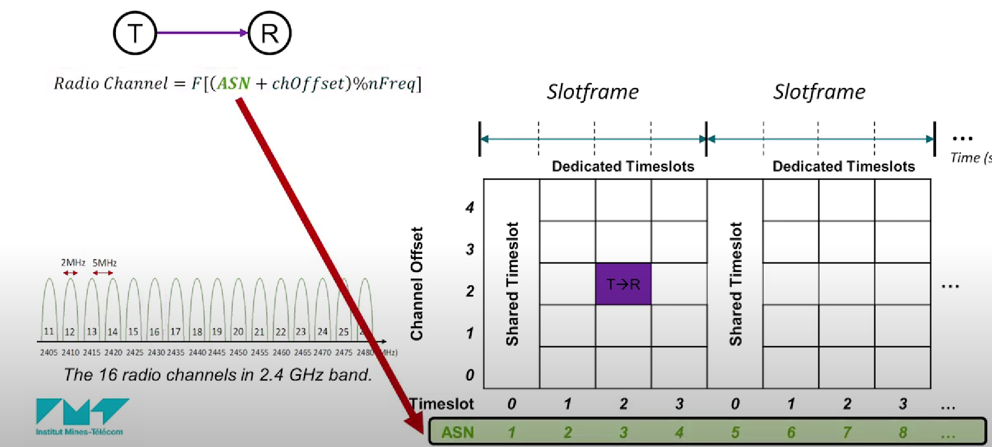
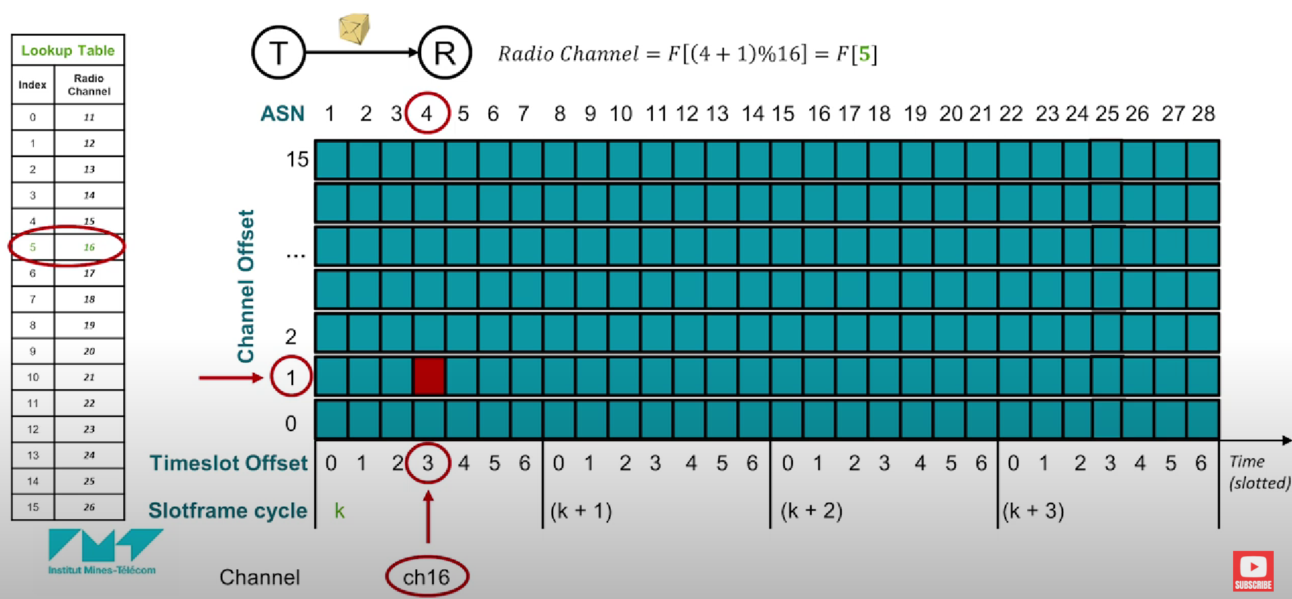


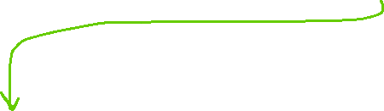


Slide 27
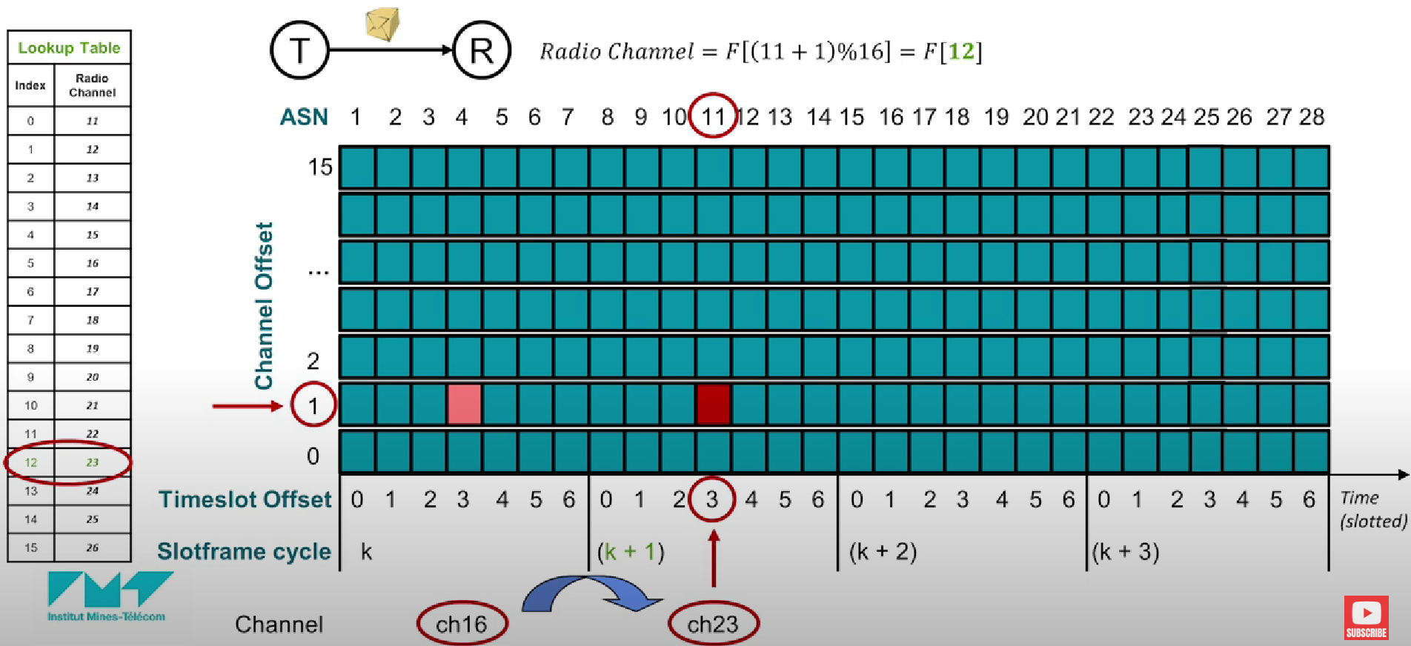
https://youtu.be/U1qDoFs7HRs?si=xkGa8dUOOM5STxxM

Slide 28
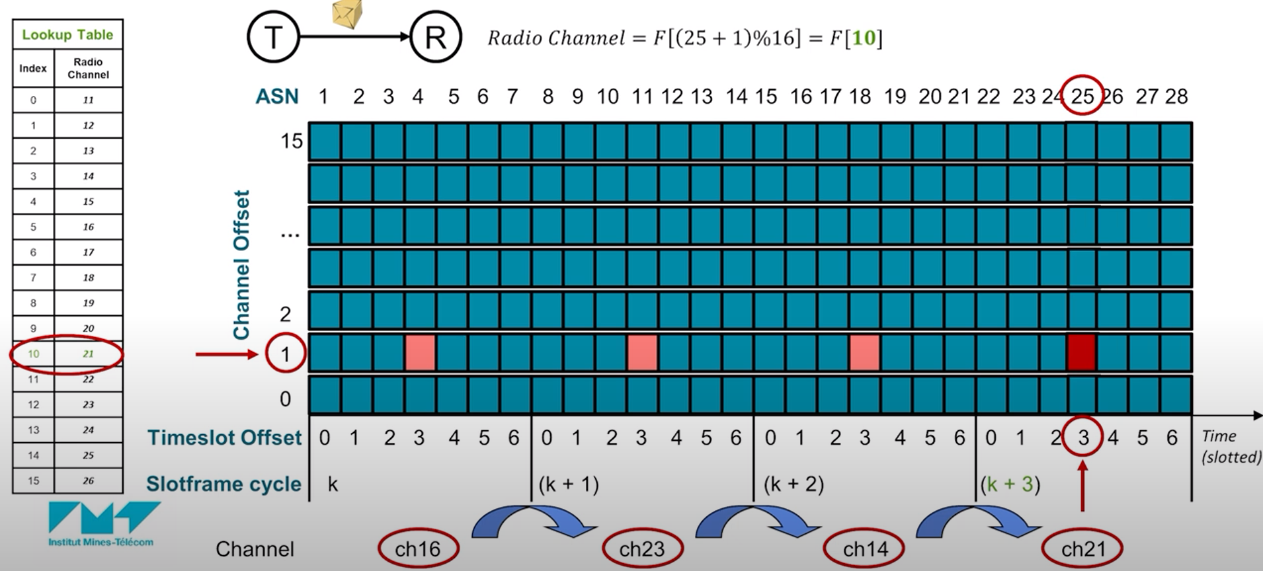

Slide 29
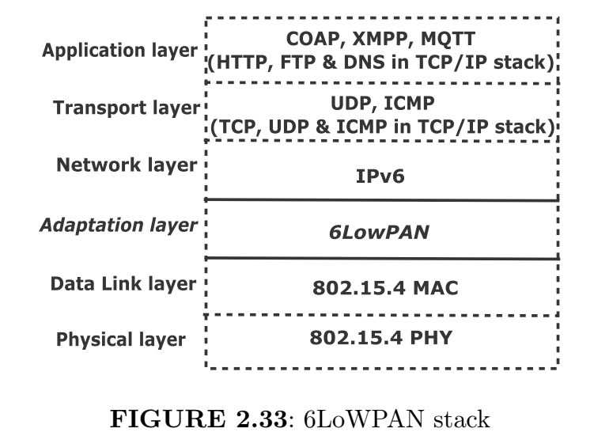
6LowPAN Stack
Physical Layer converts bits to signals and then transmitted.
Data Link Layer is responsible for detection and correction of errors during transmission. MAC layer ensures collision-free transmission of frames using CSMA/CA or CSMA/CD technique.
Adaptation Layer The maximum frame size for IEEE 802.15.4 and IPv6 are 127 and 2048 bytes, respectively. Therefore, we need an adaptation layer for compatibility. Three main functions of the layer are Header Compression and Decompression, Fragmentation and Reassembly, and Mesh Routing.
Network Layer is responsible for routing of packets using IP. The IP provides addresses to the nodes.
Transport Layer is connection-based using TCP protocol or connectionless using UDP protocol. UDP has smaller header size and hence low complex than TCP.
Application Layer

Slide 30
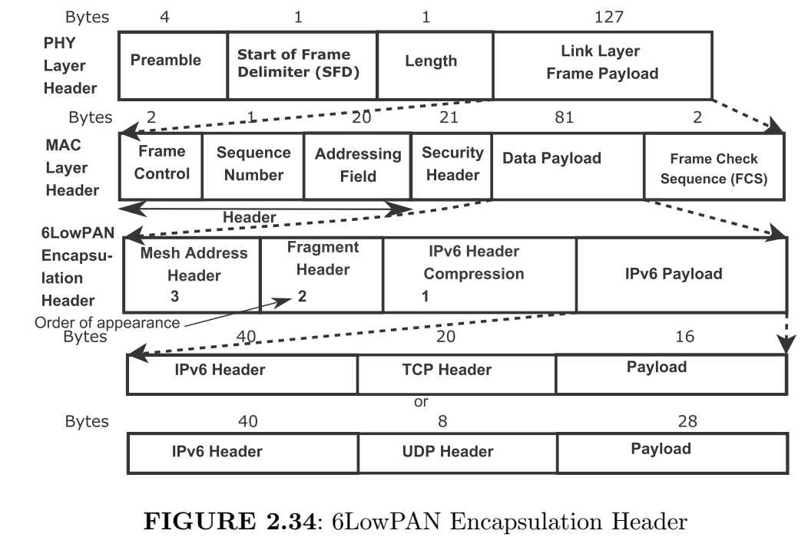
6LowPAN Encapsulation Header
6LoWPAN enables low-power, low-data-rate, short-range communication with IPv6 compatibility and mesh networking capabilities.
6LoWPAN: Low power, low data rate (up to 250 kbps), short range (10-30 meters indoors), IPv6 compatibility, and mesh networking.
IEEE 802.15.4: Low power, low data rate (up to 250 kbps), short range (10-30 meters).
IEEE 802.11 (Wi-Fi): Higher power, high data rate (up to several Gbps), longer range (up to 100 meters indoors).
LoRaWAN: Low power, low data rate, long-range communication (up to 15 km in rural areas), with strong security.

Slide 31
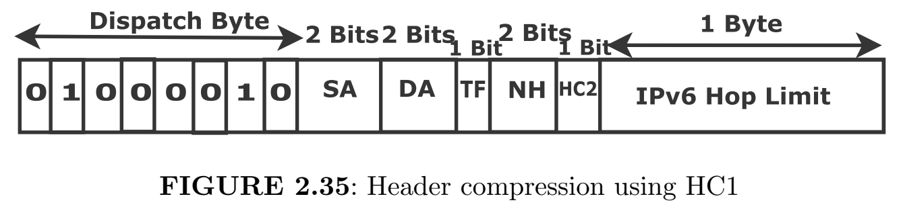
IPv6 Header Compression using HC1
The first two bits of dispatch byte are defined as follows: bits 00 for not a 6LowPAN frame, bits 01 for IPv6 addressing header, bits 10 for mesh header, bits 11 for fragmentation header.
The last two bits of dispatch byte are defined as follows: bits 01 for uncompressed and bits 10 for compressed IPv6 header. In Source Address (SA) and Destination Address (DA), first and third bits of Byte 2 are source and destination prefixes respectively. These are compressed and derived from link-layer address and 0 otherwise. The second and fourth bits of Byte 2 are source and destination interface IDs, respectively. These are compressed and derived from link-layer address and 0 otherwise. In Traffic class and Flow label (TF), bit 1 is present if both are zero. In Next Header (NH), bits 00, 01, 10, and 11 denote uncompressed header, packet uses UDP, TCP and ICMP, respectively. Finally, in HC2, bit 1 is used for compression of transport layer using HC2 and bit 0 if uncompressed.

Slide 32
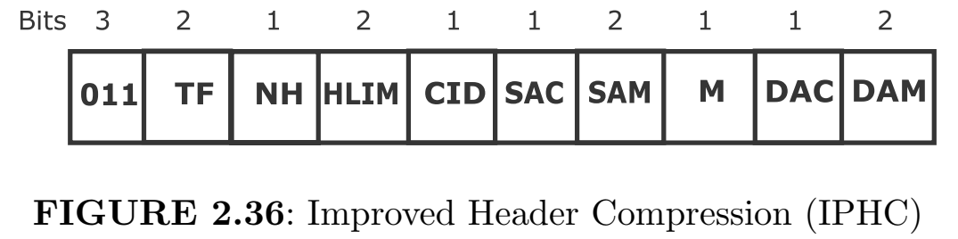
IPv6 Header Compression using Improved Header Compression (IPHC)
Let us discuss IPv6 header compression using improved header compression (IPHC). In the case of linklocal communication, 40 bytes IPv6 header can be compressed to 2 bytes in the best case. However, for routing over multiple IP hops, that can be compressed to 7 bytes. There is a context-based efficient compression technique for multicast and global IPv6 addresses in addition to link-local and unicast addresses. The prefixes of addresses are obtained from the network using a context-based approach. In Figure 2.36, bits 011 if we use IPHC, bit 0 for TF, and bit 1 for NH. Here, the next header is compressed using NHC. How the hop limit is compressed is shown in the HLIM field. This field is 00, 01, 10, and 11, for inline, 1, 64, 255, respectively. CID is Context Identifier Extension = 1. 8 bit CIE field follows after DAM (Destination Address Mode) field. S/DAC denotes Source/Destination Address Compression: whether the compression is stateless (bit 0) or context-based (bit 1). The field M is 1 if the destination address is multicast. S/DAM denotes source/destination address mode. This is used to know the number of bits or types of source/destination addresses.

Slide 33
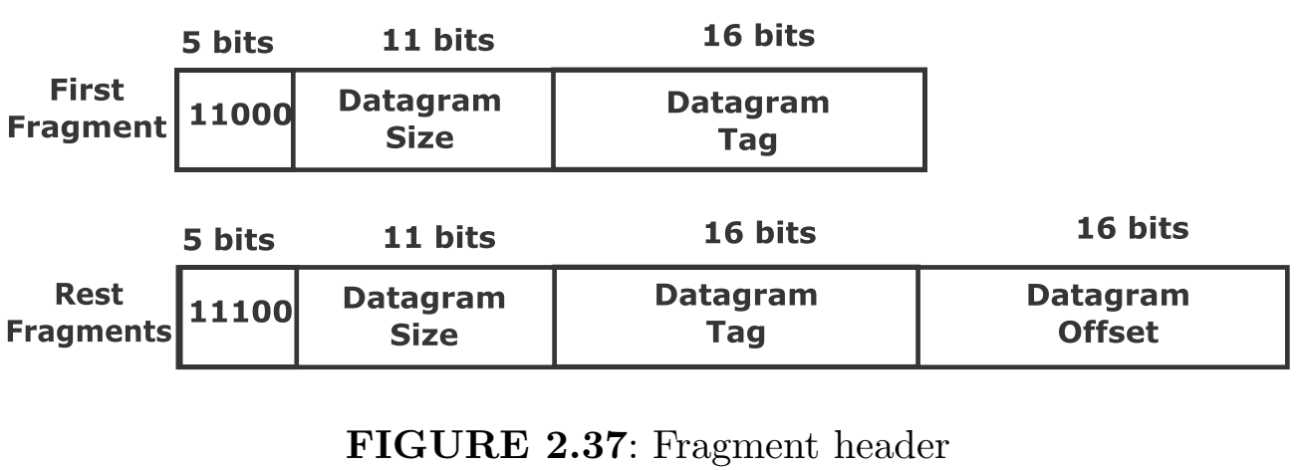
Fragment Header
A large size payload of IPv6 cannot be transmitted over IEEE 802.15.4 networks. The size of the fragment is decided by the maximum frame size at the data link layer. Adaptation layer receives the packet from the network layer and fragments it in case the unfragmented payload is too large before sending it to the MAC layer
Datagram size - so that the receiver allocates a buffer in the case out of order arrival. If any fragment arrives at the receiver, it knows the total unfragmented size. That is why the original size is included with all fragments.
Datagram tag - unique tag given to the set of fragments corresponding to the same IP packet.
Datagram offset - position of fragment within the unfragmented payload
Reassembly timer - The maximum reassembly time is 60 seconds from the receipt of the first fragment. If only some fragments arrive, then all fragments are discarded.

Slide 34
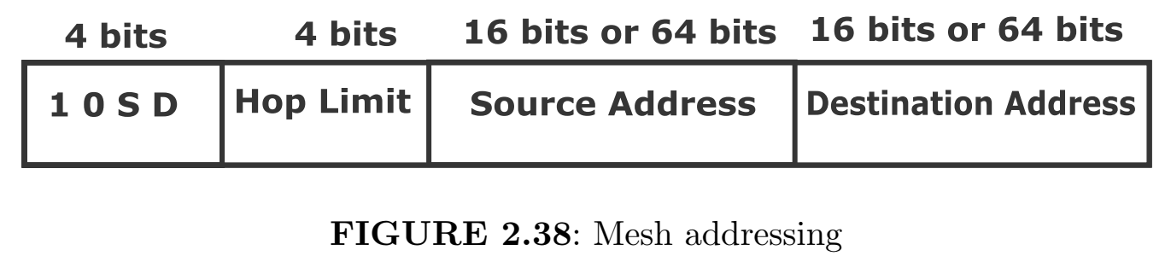
Mesh Addressing Header
routing is also done by adaptation layer in 6LowPAN.
Hop limit is the maximum number of hops for forwarding the packets. The hop limit is decremented by one at each forwarding node. The packet is discarded if the hop limit hits zero.

Slide 35
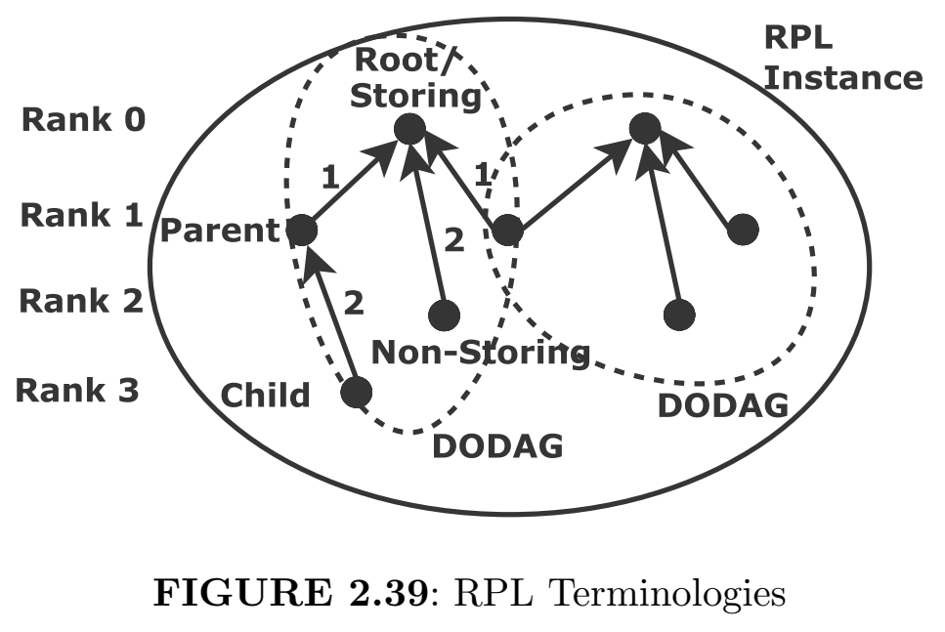
Routing Protocol in 6LowPAN (RPL)
Root is the destination node.
Rank is the distance from the root node. Rank increases from the root to the leaf node.
Parent: The edge points toward it.
Child: The edge originates. A parent can have multiple children and similarly, a child can have multiple parents.
Directed acylic graph (DAG): A graph that has no cycle.
DODAG (Destination Oriented Directed Acyclic Graph): A special DAG with a single destination for all nodes.
RPL instance: Since a node can be a member of different DODAGs each having a different objective, RPL instance is a set of DODAGs having different roots. Each RPL instance has a single objective then.
Storing node has a complete routing table and knows how to go from one node to another.
Non-Storing node has partial routing table for reaching to parent.

Slide 36
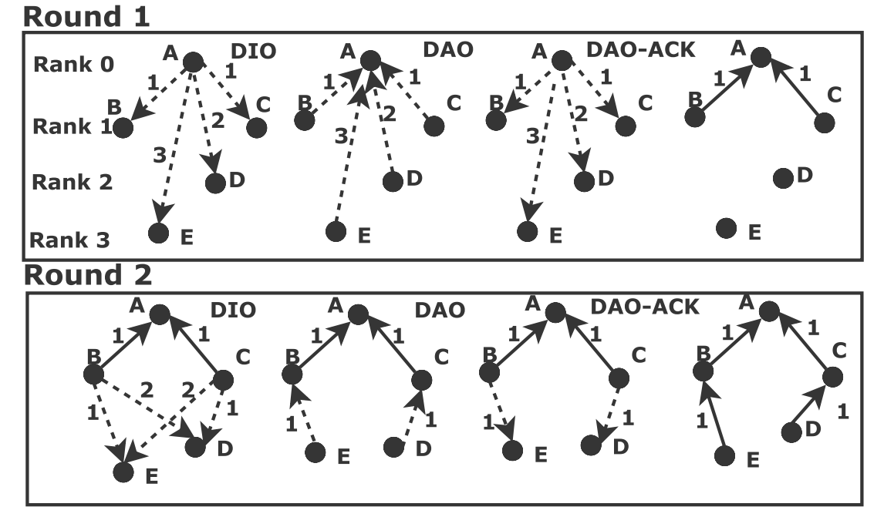
RPL Example
In round 1, Let A be root node and it sends DIOs to nodes B, C D, and E
Then, nodes B, C, D, and E know the distances with respect to node A and send DAO request messages to node A for joining.
The node A confirms the joining by DAO-ACK.
Now nodes B and C are the nearest to node A having rank 1.
In round 2, these nodes B and C send DIOs to nodes D and E.
The node D knows the distances with nodes B and C are 2 and 1, respectively. Similarly, the node E knows the distances with B and C are 1 and 2, respectively.
The nodes E and D send the DAO to the nearest nodes B and C.
Finally, nodes B and C reply with DAO-ACK to nodes E and D.
RPL Control Messages
DODAG Information Solicitation (DIS): This is a request for invitation. If a child wishes to join a DODAG in case no DIO is received.
DODAG Information Object (DIO): Parent sends an invitation to children for joining.
DODAG Advertisement Object (DAO): A child sends the request to the parent for joining DODAG.
DAO Acknowledgment (DAO-ACK): This is a confirmation from parent to child.

Slide 37
Application Protocols
An application protocol is a set of rules and conventions that define how software applications communicate over a network. They are of 2 types:
Constrained Application Protocol (CoAP): CoAP is designed for constrained devices and networks. It uses a client-server model and is optimized for low-power, low-bandwidth environments. CoAP is similar to HTTP but uses UDP instead of TCP, making it suitable for applications with limited resources.
Message Queue Telemetry Transport (MQTT): MQTT is a lightweight messaging protocol that uses a publish-subscribe model. It is designed for reliable communication in low-bandwidth, high-latency environments. MQTT operates over TCP.

Slide 38
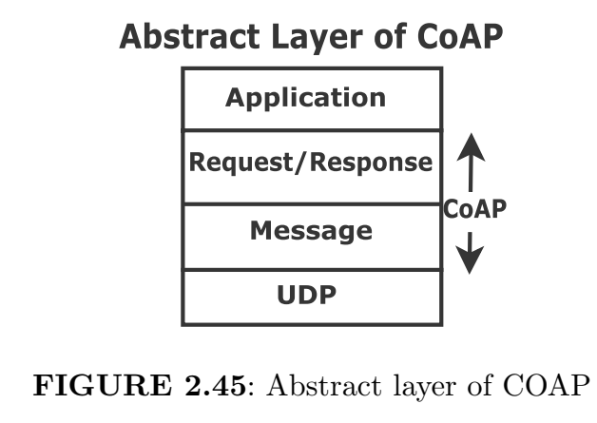
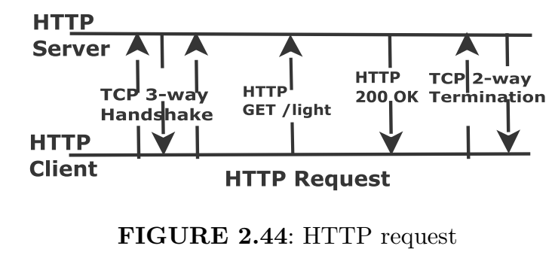
Constrained Application Protocol (CoAP)
A light-weight CoAP is designed for constrained devices of IoT networks, in contrast to HTTP which has high complexity and high energy consumption.
As we know, TCP is a connection-oriented protocol for high-reliability applications. This has high complexity. On the other hand, UDP is a connection-less protocol and the complexity is low. HTTP uses TCP and CoAP uses UDP as transport layer protocols.
There are four types of messages, namely, confirmable, non-confirmable, acknowledgment, and reset. Also, there are four methods in request/response layer, namely, GET, PUT, POST, and DELETE.

Slide 39
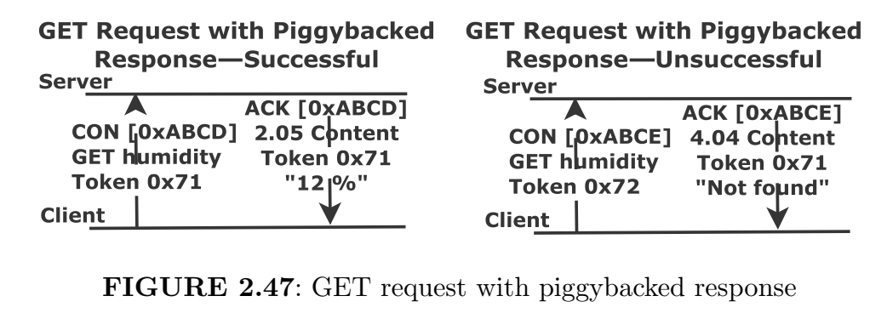
Request/Response Models in CoAP:
Token is used in order to match response and request. The token is different from the message ID. The token is a request ID. Every request should have a token even of zero length. A 2.05 (content) or 2.03 (valid) response code is part of the response in the success case. We get 2.05 and 2.03 from the message format to be discussed next.
If the response to a request by CON message is immediately ready, then the response is carried in ACK message. This is called piggybacked response as shown in Figure 2.47. Acknowledgment to piggybacked response is not sent assuming that the client requests again if the ACK carrying the piggybacked response is lost.

Slide 40
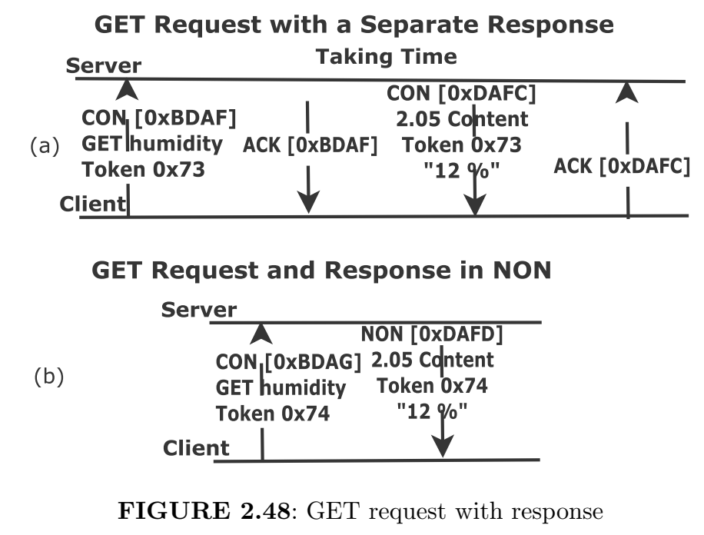
Separate Response in CON and NON in CoAP:
Unlike piggybacked response, when the server is not ready, it sends an empty ACK to avoid further retransmission of request from the client as shown in Figure 2.48(a). Later, when the server becomes ready, it sends a new CON message which is acknowledged by the client. If a request is made using a NON-message, then the response is also in a separate NON-message in Figure 2.48(b).

Slide 41
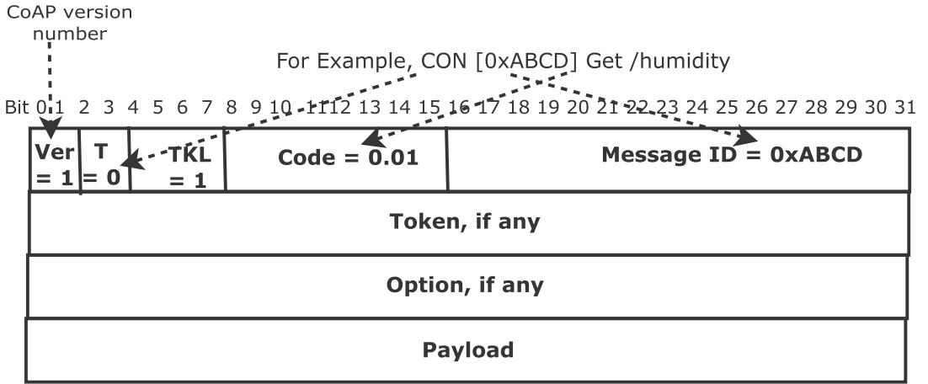
Message Format in CoAP:
The message header is fixed-size 4 bytes followed by message which consists of variable-length token value (0 to 8 bytes size), optional options and payload.
Version (Ver) field of CoAP is a version number which is of 2 bits.
Type (T) is made of 2 bits: 0 for confirmable, 1 for non-confirmable, 2 for ACK and 3 for reset.
Token Length (TKL) is of 4 bits. The size of variable-length token field is between 0 and 8 bytes.
CODE is of 8 bits out of which 3 most significant bits for class (0 to 7 in decimal) and 5 least significant bits for code (00 to 31 in decimal) in the form x.yy.
Message ID is of 8 bits for detecting message duplication, and to match ACK message with CON/NON message.

Slide 42

Message Queue Telemetry Transport Protocol (MQTT)
The protocol is suitable for constrained devices. It provides high throughput and low latency than CoAP. It supports multicast communication, and uses the publish-subscribe model as discussed before.
QoS Level 0: The sender tries at most once and the delivery is not guaranteed. The receiver does not send an acknowledgment. The message is neither stored nor re-transmitted. This is simple and has a low overhead.
QoS Level 1: The sender stores and retransmit multiple times till the receipt of the acknowledgment from the receiver, that is, at-least once. The delivery is guaranteed, however, duplicate message is possible.
QoS Level 2: The message is delivered only once, that is exactly once. For example, billing system (invoice).

Slide 43
MQTT Wild Cards
Wild card is used by the subscriber, not the publisher to filter messages.
(+) Single level: This matches any string for a single topic level at the position in the topic filter (+). For example, topic filter iot/+/EEG publishes iot/sensor libelium/EEG, iot/eHealthSens/EEG, iot/sensor5/EEG amongst others.
(#) Multi-level: This matches any string for zero or multiple topic levels at the end of topic filter. For example, if we want to receive all the messages related to all the ehealthSens of IoT, we use topic filter iot/ehealthSens/#. We then receive iot/ehealthSens/EEG, iot/ehealthSens/ECG, iot/ehealthSens/EEG/singleChannel, iot/ehealthSens/EEG/singleChannel/5, iot/ehealthSens/battery amongst others.

